Slide 1
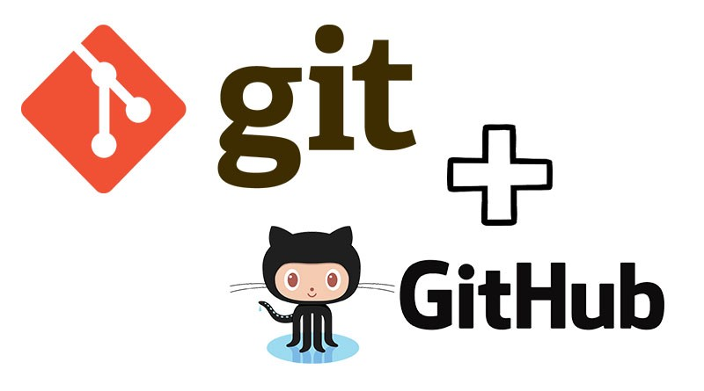
Introduction to Git & GitHub
Md. Mehedi Hasan
M.Sc. Student (Thesis)
Department of Statistics(RU)
Intern (icddr,b)

Slide 2
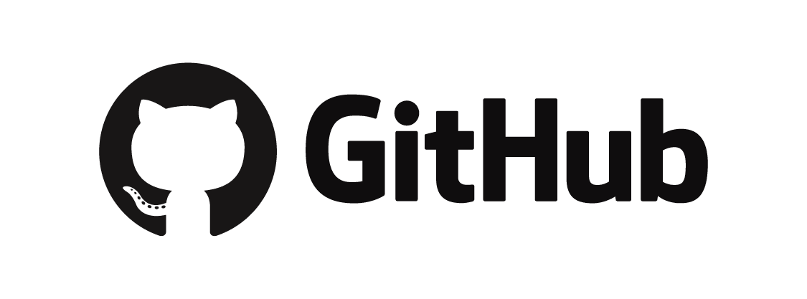
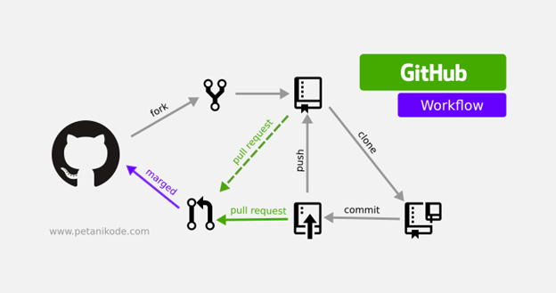
GitHub : GitHub, Inc. is a United States-based global company that provides hosting for software development version control using Git. It is a project management and a code version control system as well as a social network platform made for developers.
To understand exactly what GitHub is, you need to know two connected principles:
Version control
Git

Slide 3
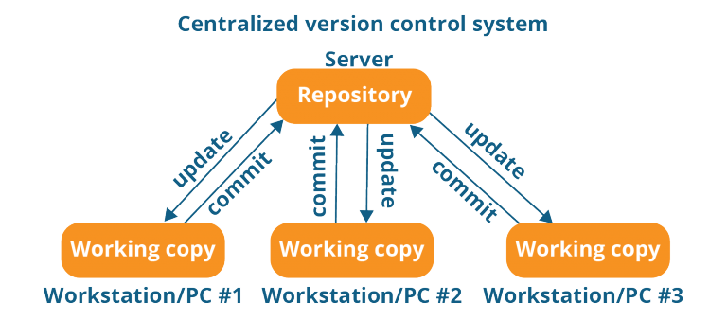
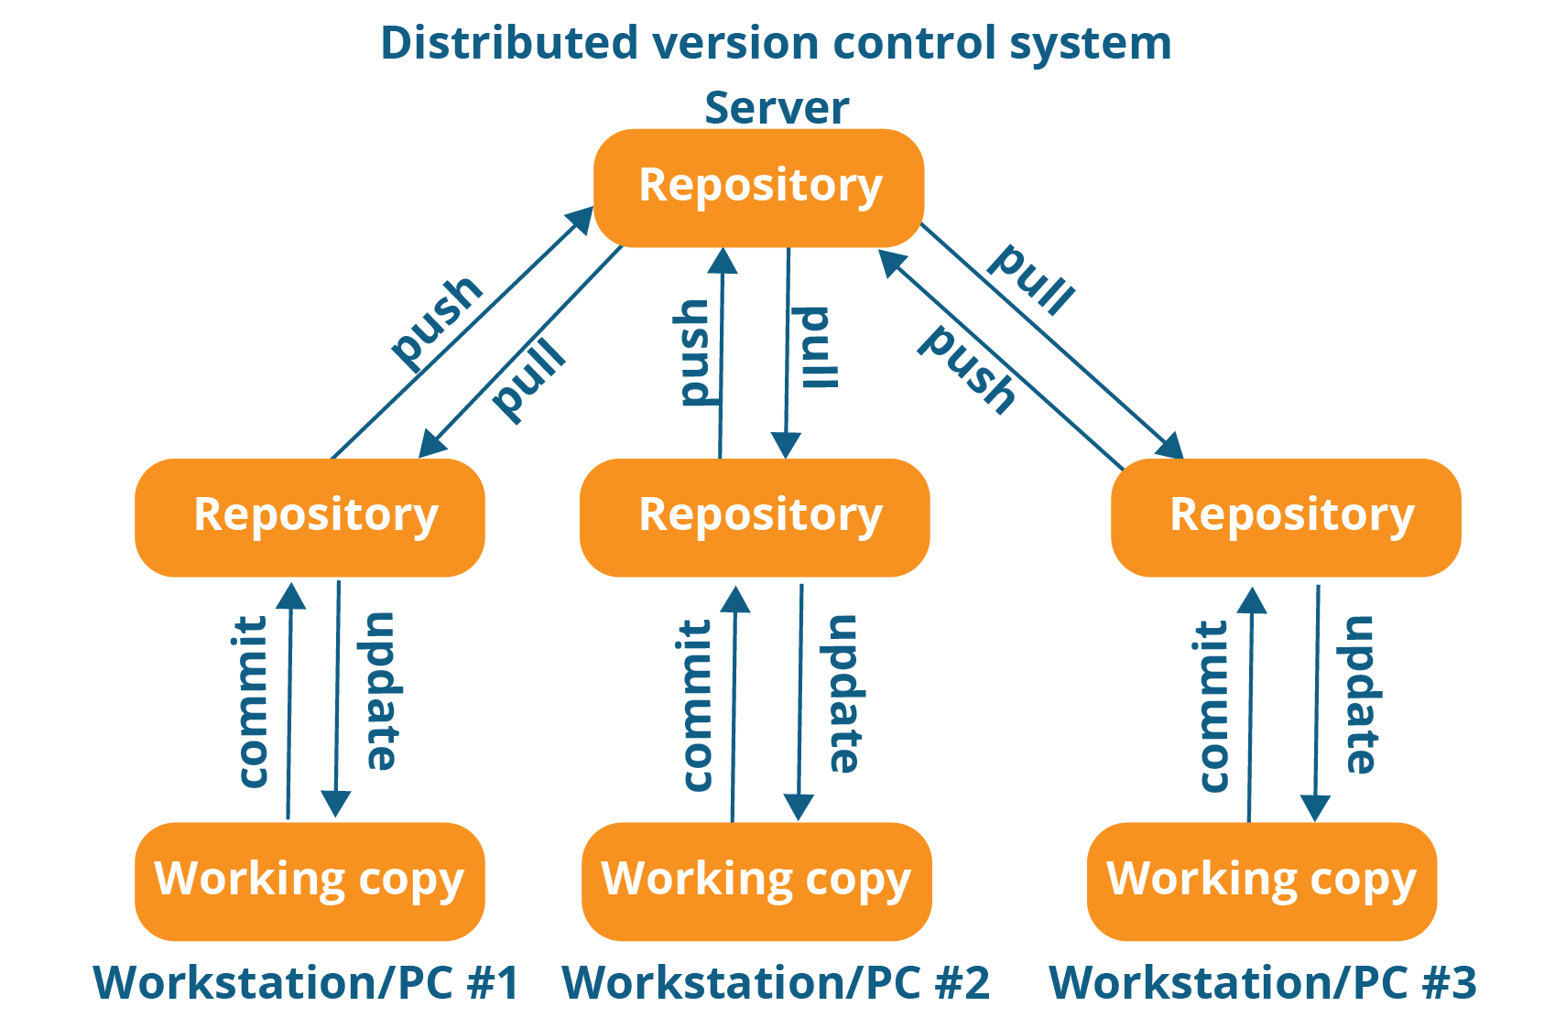
Version Control System
Version Control : Version control is like a savings program for your project. By tracking and logging the changes you make to your file or file sets over time, a version-control system gives you the power to review or even restore earlier versions. Version control takes snapshots of every revision to your project. You can then access these versions to compare or restore them as needed.

Slide 4
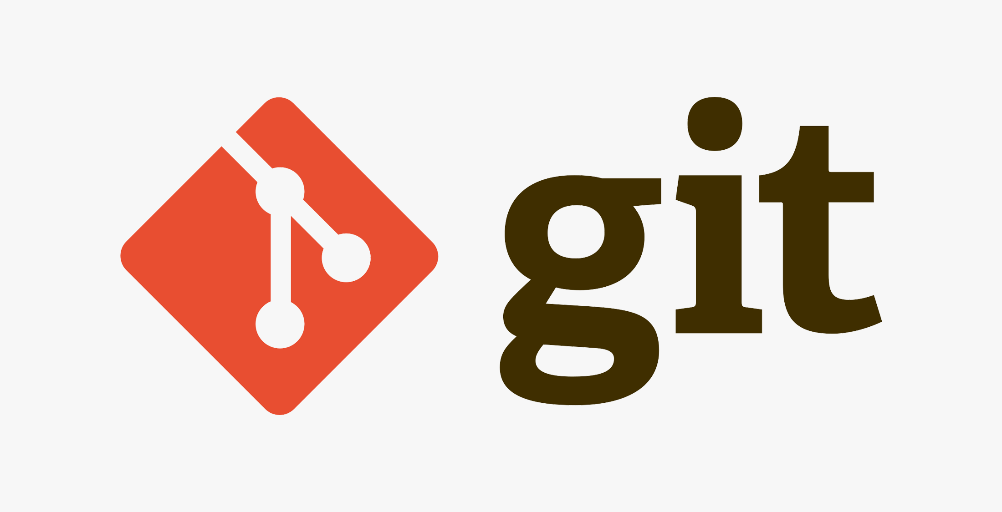
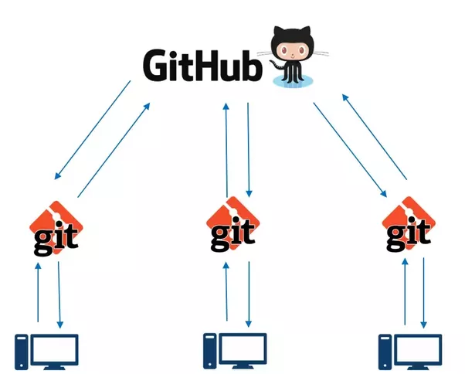
Git
Git : Git is a free and open source distributed version control system designed to handle everything from small to very large projects with speed and efficiency. It was created by Linus Torvalds in 2005. It helps developers keep track of the history of their code files by storing them in different versions on its own server repository, i.e., GitHub. Git has all the functionality, performance, security, and flexibility that most of the development teams and individual developers need.
You’ll find all the git commands here :
https://www.atlassian.com/git/tutorials/atlassian-git-cheatsheet

Slide 5
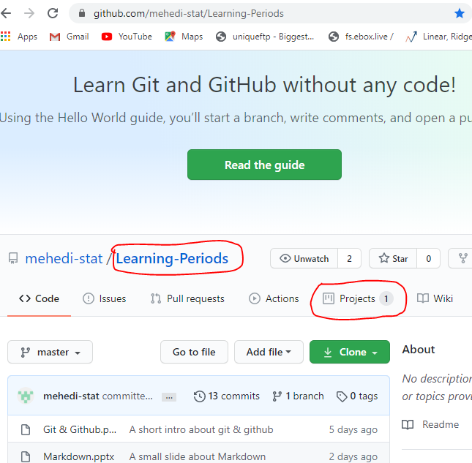
Github Repository & project
Repository : GitHub repositories are where we store code. We create a repository then we can connect our local git repository to that remote repository and push up changes, created branches, and share our code with our team.
Project : A GitHub project is a place to track issues, features, and other tasks related to the code in the repository. We can also connect up with a DevOps build and deploy process, assign people to tasks, and so forth.
In the picture Learning-Periods is a repository and 1 project is created in the repository.

